Slide 1
Final Porject
Checkpoint 1

Slide 2
Spherical Harmonics
“Special functions defined on the surface of a sphere”
Form a complete set of orthogonal functions (orthonormal basis)

Slide 3
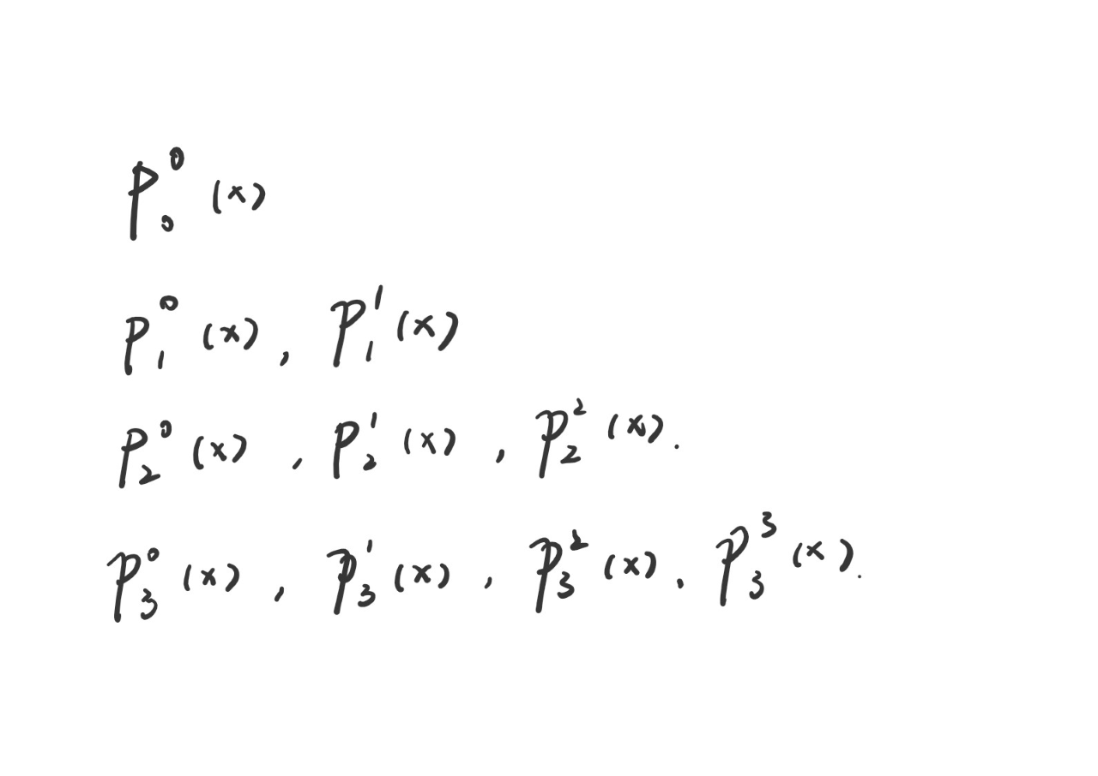
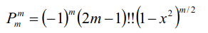
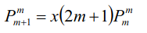
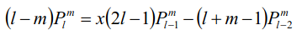
Equations-1D Legendre Polynominals

Slide 4
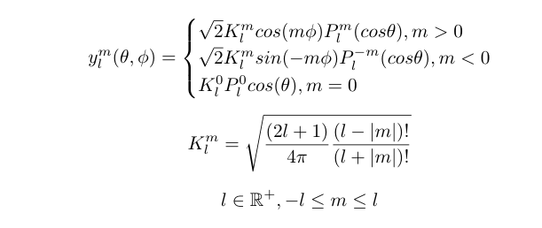
Equations-2D

Slide 5
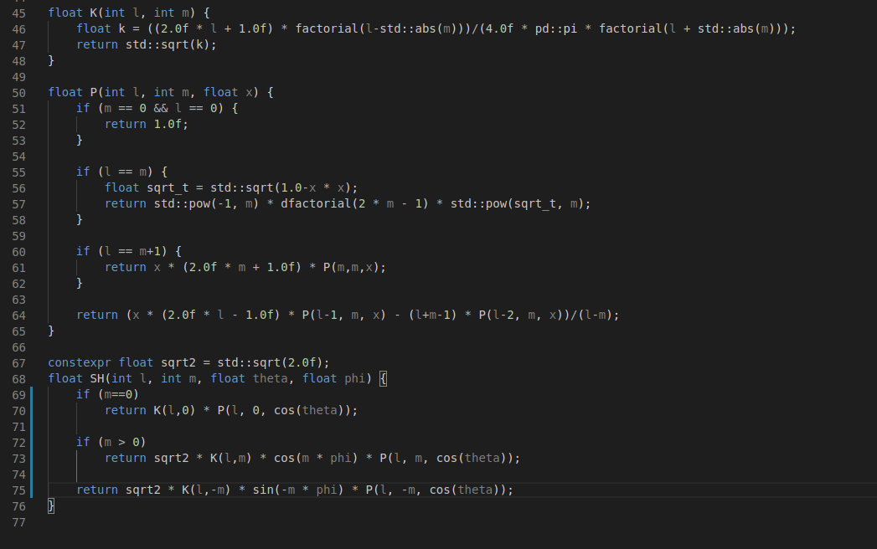
Implementations (CPU)

Slide 6
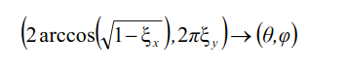
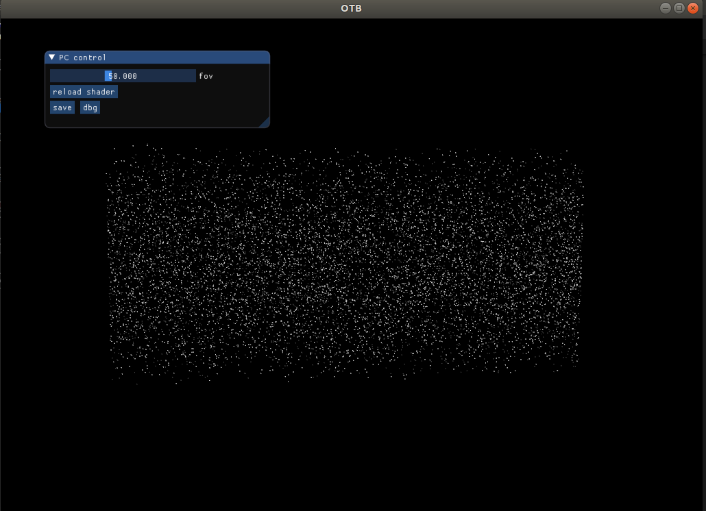
Uniform samples from sphere

Slide 7
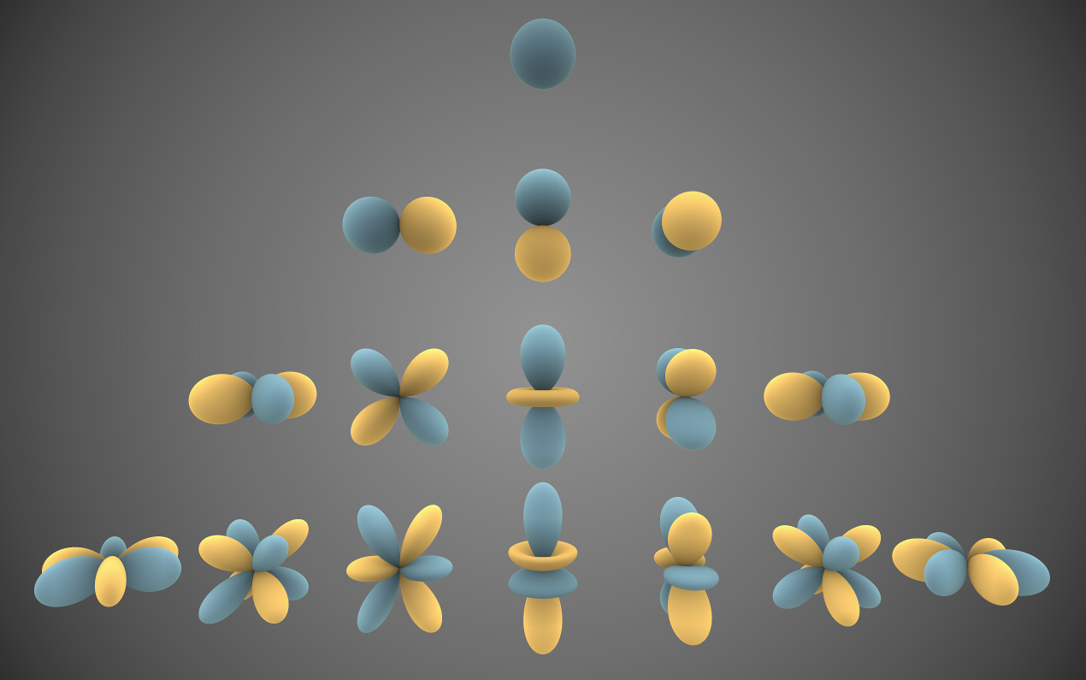
SH

